Slide 1
Restraint and Seclusion Incident Reporting
June 2022

Slide 2
Table of Contents
Basic font sizes
Section 1: Overview and Introduction
(Slides 3-6)
Bullet points, lines and shapes
Section 2: Starting the Report
(Slide 7)
Section 3: Providing District Information
(Slides 8-12)
Sequences and timelines
Section 4: Providing Building Information
(Slides 13-22)
Section 5: Completing the Report
(Slide 23)
Images and text
Section 6: Frequently Asked Questions (FAQs) for Traditional Districts, Community Schools and Education Service Centers (ESCs)
(Slides 24-30)
Numbers
Click on the button in slide show mode to go directly to the corresponding section.

Slide 3
Overview
Ohio rule (2013, revised 2021) outlines standards for the:
Implementation of positive behavior intervention supports
Use of restraint and seclusion

Slide 4
Overview
The rule requires districts to annually report incidents of restraint and seclusion to the Department.
This data collection fulfills the district’s reporting requirement.
Submit data from 2021-2022 school year by on Aug. 5, 2022.

Slide 5
Positive Behavior Intervention and Supports (PBIS) | Crisis Management and De-escalation (Restraint and Seclusion)
First component of the Rule | Second Component of the Rule
Proactive approach | Reactive interventions
Help reduce challenging behavior that may escalate to the point of a safety concern. | Used when behavior has escalated to a point of safety concerns.
Focus on creating a safe, predictable and supportive school environment by routinely teaching, practicing and reinforcing expected behaviors. | Staff attempt to de-escalate a student through verbal prompts, time for processing decisions and space.
Uses multitiered model: universal supports (tier I), targeted supports (tier II), and individual supports (tier III). | If the unsafe behavior continues, the crisis intervention team may use physical restraint as a last resort in order to keep the student and others safe.
Basic font sizes
Sequences and timelines
Images and text
Numbers

Slide 6
Restraint and Seclusion Data Collection
School districts and each building must complete both sections of the data collection to finalize the report.
District level: Questions address district policies
Building level: Questions address specific number of student incidents of restraint and seclusion

Slide 7
Where do you begin?
Email to district superintendent from Ohio-K12 has information and resources
Email will include district-specific link to the report.
If you cannot locate your link - support@ohio-k12.help
Notes:
Your district’s superintendent will receive an email from Ohio-K12 containing information with resources about the data collection.
The email will include a link specific to your district, which will take you to the report. If you cannot locate your link please email support@ohio-k12.help

Slide 8
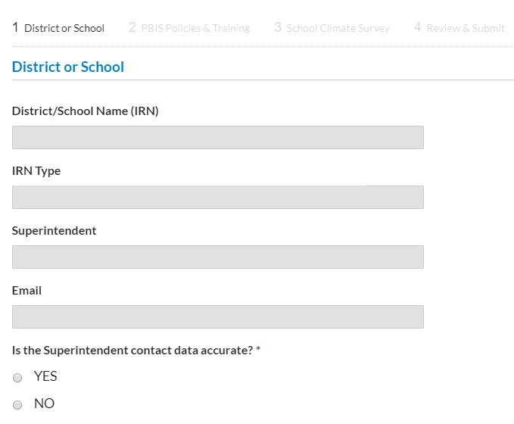
District Information
This section is a confirmation of your district's information.
Much information is already populated.
If the Superintendent contact information is accurate, click yes or no.
Notes:
This section is a confirmation of your district's information.
Your district's name with corresponding IRN is populated, including the Superintendent's name and email address.
If the Superintendent contact information is accurate, click yes or no.

Slide 9
District Information
Question: Indicate whether your district has revised policies and procedures concerning the use of PBIS and restraint and seclusion, to align with Ohio’s revised rule (June, 2021).
Answer: Select “yes” if your district has revised its policy since June 2021, or “no” if your district has not revised its policy.

Slide 10
District Information
The second section of the data collection addresses school climate surveys* and only requires completion if you are a traditional public school, community school or STEM school.
* School climate surveys are not required
for Ohio districts and schools.
Notes:
The second section of the data collection addresses school climate surveys* and only requires completion if you are a traditional public school, community school or STEM school.
* School climate surveys are not required
for Ohio districts and schools

Slide 11
District Information- School Climate
The 1st question asks if your district administered a School Climate Survey during the 2021-2022 school year and the name of the survey. If you click no, you will be directed to Part 4 of the survey. If you select that you administered an existing survey it will ask for details.
The 2nd question asks what dimensions of school climate were covered by the School Climate Survey issued during the 2021-2022 school year. Select all applicable boxes.
The 3rd question asks when the School Climate Survey was administered during the 2021-2022 school year. Select the appropriate timeframe.
The 4th question asks if the School Climate Survey was administered district wide or to only certain schools during the 2021-2022 school year. Select the appropriate box.
The 5th question asks who in your district completed School Climate Surveys during the 2021-2022 school year. Select all applicable boxes.
The 6th question and 7th questions asks the approximate response rate for students and teachers of the School Climate Survey during the 2021-2022 school year. Select the appropriate boxes.

Slide 12
District Information- School Climate
The 8th question asks how the results of the School Climate Survey were used during the 2021-2022 school year. Select all applicable boxes.
The 9th question asks in what ways could your school benefit from guidance or support in the use of the School Climate Survey(s) for the 2022-2023 school year. Select the appropriate boxes.
The 10th question asks in which areas does your district or school align School Climate activities for the 2021-2022 school year. Select the appropriate boxes.
The 11th question asks how long your district has been administering School Climate Surveys. Select the appropriate box.
The 12th question asks who in your district administers School Climate Surveys. Select the appropriate boxes.
The final question asks for additional information or perspectives on School Climate Surveys that you would like to share with the Department.

Slide 13
School Building Incident Reporting
The building section of the data collection must be
completed separately for each building in your district.
If a building from your district is missing, or is incorrectly
listed, please contact support@ohio-k12.help for assistance.
Notes:
[When presenting, this slide requires multiple clicks to reveal each element]

Slide 14
School Building Incident Reporting
Training/PD: trauma-informed approaches or practices in a school environment.
Has specific building received training/PD about trauma-informed practices in a school setting.
Answer yes or no.
Notes:
*Trauma-informed practices are not required for Ohio districts and schools. However, these practices have demonstrated effectiveness in restraint and seclusion reduction efforts.

Slide 15
School Building Incident Reporting
Effective for the 2021-2022 school year, the revised rule states after a student’s third incident of restraint or seclusion, a team will meet to discuss the need to conduct or review a functional behavioral assessment (FBA) and/or behavior intervention plan (BIP).
The meeting must occur within 10 school days of the third incident.
If the Student has an IEP or 504 Plan, the meeting must be with the student’s IEP or 504 Plan team.
If the Student is a general education student, the team must include the parent or guardian, an administrator or designee, a teacher of the student, at least one staff member involved in the incident(s) and any other appropriate staff members.
Third Incident of Restraint or Seclusion: Has the school building developed a procedure to flag the third incident of restraint or seclusion for a student in order to ensure a meeting is held to discuss whether an FBA or BIP needs created or revised?
Answer yes or no.

Slide 16
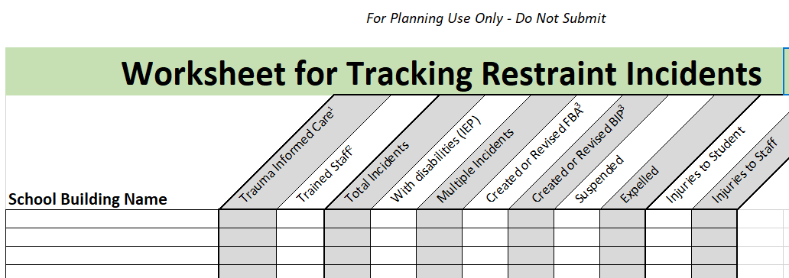
School Building Incident Reporting Part 3: Restraint Worksheet
The next step is to enter restraint incidents per building. It may be helpful to complete the Worksheet for Tracking Restraint Incidents.

Slide 17
School Building Incident Reporting Part 3: Restraint Worksheet
School Building Name: List the name of the specific school building in the district that you are reporting on.
Trauma-Informed Approaches: See slide 15 for review.
Trained Staff: See slide 16 for review.
Total Incidents of Restraint: List the total number of incidents of restraint in the specific building during the 2021-2022 school year. See Restraint and Seclusion Definitions for guidance.
Total Incidents of Restraint - Students With IEPs: Of the total number of incidents of restraint, how many incidents involved a student with an IEP? The number entered must not exceed the total incidents of restraint you provided in the previous question.
Multiple Incidents: Provide the number of students who had more than one restraint. Include both IEP and non-IEP students. The number entered must not exceed the total incidents of restraint you provided in the prior question.

Slide 18
School Building Incident Reporting Part 3: Restraint Worksheet
Created or Revised Functional Behavioral Assessment: Of the total number of restraint incidents, provide the number of incidents which resulted in the creation or amendment of a functional behavioral assessment (FBA).
Created or Revised Behavior Intervention Plan: Of the total number of restraint incidents, provide the number of incidents which resulted in the creation or amendment who of a behavior intervention plan (BIP).
Restraint Resulting in Suspension: Of the total number of restraint incidents, provide the number of those incidents which resulted in suspension.
Restraint Resulting in Expulsion: Of the total number of restraint incidents, provide the number of those incidents which resulted in expulsion.
Restraint Resulting in Injury to Students: Of the total number of restraint incidents, provide the number of incidents which resulted in an injury to students.
Restraint Resulting in Injury to Staff: Of the total number of restraint incidents, provide the number incidents when staff were injured.

Slide 19
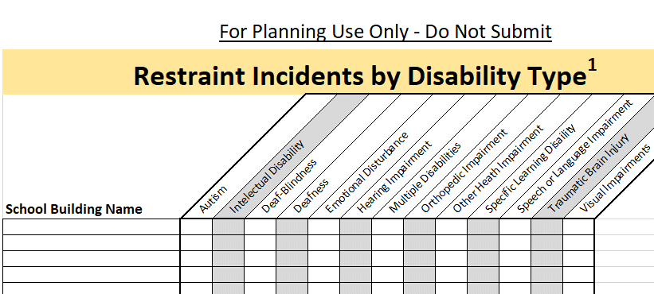
School Building Incident Reporting Part 3: Restraint Incidents by Disability Category Worksheet
The next step is completion of the Worksheet for Restraint Incidents by Disability Category specific to each building in your district.
For the total incidents of restraint for students with IEPs in your building, provide the amount of each disability category. The total number of students in each category should NOT exceed the number entered on the previous page.
If you did not have any students restrained during the 2021-2022 school year, OR the students restrained in your building did NOT have IEPs, do not enter any information.
Notes:
The next step is completion of the Worksheet for Restraint Incidents by Disability Category specific to each building in your district.
For the total incidents of restraint for students with IEPs in your building, provide the amount of each disability category. The total number of students in each category should NOT exceed the number entered on the previous page.

Slide 20
School Building Incident Reporting Part 3: Seclusion Worksheet
The next step is entering seclusion incidents per building. It may be helpful to complete the Worksheet for Tracking Seclusion Incidents.

Slide 21
School Building Incident Reporting Part 3: Seclusion Worksheet
School Building Name: List the name of the specific school building in the district that you are reporting on.
Trauma-Informed Approaches: See slide 15 for review.
Trained Staff: See slide 16 for review.
Total Incidents: List the total number of incidents of seclusion, in the specific building, during the 2021-2022 school year. See Restraint and Seclusion Definitions for guidance.
Total Incidents of Seclusion- Students with IEPs: Of the total number of incidents of seclusion, how many incidents involved a student with an IEP? The number entered must not exceed the total incidents of restraint you provided in the previous question.
Multiple Incidents: Provide the number of students who had more than one seclusion. Include both IEP and non-IEP students. The number entered must not exceed the total incidents of restraint you provided in the prior question.

Slide 22
School Building Incident Reporting Part 3: Seclusion Worksheet
Created or Revised Functional Behavioral Assessment: Of the total number of seclusion incidents, provide the number of incidents which resulted in the creation or amendment of a functional behavioral assessment (FBA).
Created or Revised Behavior Intervention Plan: Of the total number of seclusion incidents, provide the number of incidents which resulted in the creation or amendment of a behavior intervention plan (BIP).
Seclusion Resulting in Suspension: Of the total number of seclusion incidents, provide the number of those incidents which resulted in suspension.
Seclusion Resulting in Expulsion: Of the total number of seclusion incidents, provide the number of those incidents which resulted in expulsion.
Seclusion Resulting in Injury to Students: Of the total number of seclusion incidents, provide the number of incidents when students were injured.
Seclusion Resulting in Injury to Staff: Of the total number of seclusion incidents, provide the number incidents when staff were injured.

Slide 23
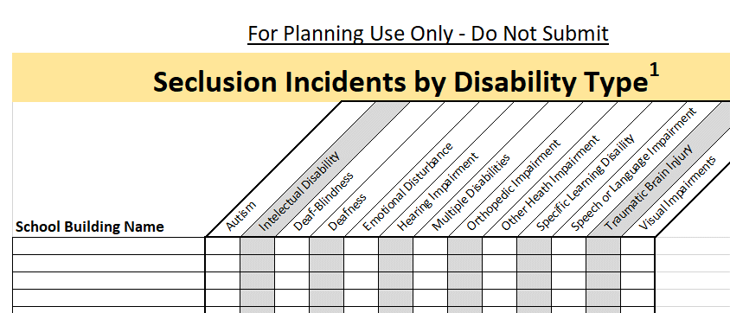
School Building Incident Reporting Part 3: Seclusion Incidents by Disability Category Worksheet
The next step is completion of the Worksheet for Seclusion Incidents by Disability Category specific to each building in your district.
For the total incidents of seclusion for students with IEPs in your building, provide the amount of each disability category. The total number of students in each category should NOT exceed the numbered entered on the previous page.
If you did not have any students secluded during the 2021-2022 school year, OR the students secluded in your building did NOT have IEPs, do not enter any information.

Slide 24
Completing the Report
Both district section and all building sections must be completed to get credit for the data collection
Once your district has completed the data collection, your superintendent will receive an email confirmation that contains two PDFs. One PDF contains answers to the data collection for your district. The other PDF contains answers to data collection for each school building within your district.
Please save the confirmation and PDFs for your records. You will not be able to access the PDFs after the reporting window has closed.

Slide 25
Frequently Asked Questions

Slide 26
Frequently Asked Questions
How do I get a new link to the data collection?
Answer: Please contact support@ohio-k12.help. This is the only way to get a new link.
How do I correct a previously submitted data collection?
Answer: Please contact support@ohio-k12.help.

Slide 27
Frequently Asked Questions
Who is required to report?
Answer: The following public agencies are required to report:
Local, exempted village, city, joint vocational or cooperative school district as defined in Chapter 3311 of the Revised Code;
An educational service center (ESC) that operates a school or educational program;
A community school as defined in Chapter 3314 of the Revised Code;
A science, technology, engineering and mathematics school as defined in Chapter 3326 of the Revised Code; or
A college-preparatory boarding school as defined in Chapter 3328 of the Revised Code.
For purposes of this rule, the term does not include schools operated in facilities under the jurisdiction of the Department of Rehabilitation and Corrections or the Department of Youth Services to report. See OAC 3301-35-15 for more information.
I completed the data collection, but I did not receive a confirmation email. Why?
Answer: Your district’s superintendent will receive a confirmation email once the data collection is completed. Check that both the district and building level sections are complete.

Slide 28
Frequently Asked Questions
We have a new superintendent, and their contact information has changed. How do we get this updated?
Answer: Please contact support@ohio-k12.help to update your superintendent’s contact information. Additionally, you should contact the Ohio Educational Directory System (OEDS) at OEDS.ContactUs@education.ohio.gov to update your superintendent's contact information.

Slide 29
Frequently Asked Questions
How often are we required to report this information?
Answer: Restraint and seclusion data is provided to the Ohio Department of Education annually. See O.A.C. 3301-35-15 for more information.

Slide 30
Frequently Asked Questions
We have a student who is receiving services from an ESC or a county board of developmental disabilities (Board of DD), who reports for the student?
Answer: For a student receiving services from an ESC or Board of DD, the district, ESC or Board of DD must work together to establish which entity will report.
Additionally, if an ESC or Board of DD works with multiple districts, the reporting expectations may be different depending on a school district’s preference.
See Who is Responsible for Reporting Restraint and Seclusion for additional information.
Notes:
District and ESCs and Boards of DD must work together to establish which entity will be reporting
Report all incidents of restraint and seclusion that occurred at the ESC or Board of DD for the district’s students; or
Authorize the ESC or Board of DD to report information on the use of restraint and seclusion directly.

Slide 31
Community School
Frequently Asked Questions

Slide 32
Frequently Asked Questions
We are an online school. Do we still have to report?
Answer: All community schools are required to report, and to have policies and procedures regarding the use of restraint, seclusion and positive behavior interventions and supports (PBIS). An online school would complete Part 1 (District Information) of the data collection, and if there were no incidents of restraints or seclusions, enter 0s in the column. See OAC 3301-35-15 for more information.
Our school did not exist last year. How do we report?
Answer: If the school's name and/or sponsor has changed from the previous year, but the school’s Information Retrieval Number (IRN) has NOT changed – complete both parts of the data collection (i.e., district level and building level) using the information from that IRN. Schools whose IRN was not established in the previous school year must contact PBIS_Restraint_Seclusion_Questions@education.ohio.gov.

Slide 33
Stay Connected
PBIS_Restraint_Seclusion_Questions@education.ohio.gov

Slide 34
@OHEducation

Slide 35
Share your learning community with us!
#MyOhioClassroom
Celebrate educators!
#OhioLovesTeachers

